Slide 1
SAP BTP Build Apps Training
Day 2
Anubhav Oberoy
www.AnubhavTrainings.com
Follow excellence with sheer passion

Slide 2


DISCLAIMER
The training content and delivery of this presentation is confidential, and cannot be recorded, or copied and distributed to any third party, without the written consent of Anubhav Trainings

Slide 3
Agenda
01
BTP Subs/Env./Services
02
Fusion Team
03
Build workzone

Slide 4
Environments, Subs, and services
Environments
Environments constitute the actual platform-as-a-service offering of SAP BTP that allows for the development and administration of business applications. Environments are anchored in SAP BTP on subaccount level.
SAP BTP offers three environments: ABAP, Cloud Foundry and Kyma. Some existing customers still have Neo, but this is no longer offered.
Subscription based services
You will also see these ones called software as a service (SaaS), or multitenant applications. The experience here is that you subscribe to the service, and in return you receive a URL, from which you can access that service. Opening the URL brings you to a web application from which you can leverage the service. This is how other SaaS like SuccessFactors or S/4HANA Cloud work as well. They are also enabled at a subaccount level, and are independent of the environments. You don’t need to have Cloud Foundry enabled to subscribe to SAP Launchpad Service, for example.
Examples include Launchpad, SAP Business Application Studio, Cloud Integration, Process Automation…
Instance based services
These are the purest services. They provide a specific functionality, like databases, connectivity, authentication…. You connect your application to them to leverage that functionality. These services don’t provide a UI to manage them. Instead, they rely on API to connect to applications and other services and provide their services. They are provisioned inside an environment, so they are environment specific. Each environment has its own organization (for users and applications): In Cloud Foundry, instances are created inside a space. For Kyma, instances are created inside a namespace.

Slide 5
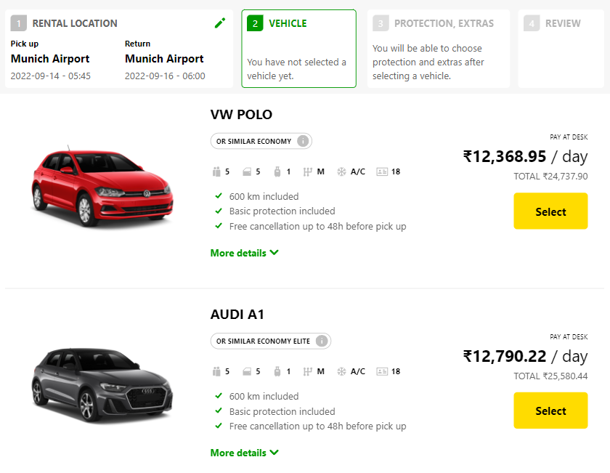
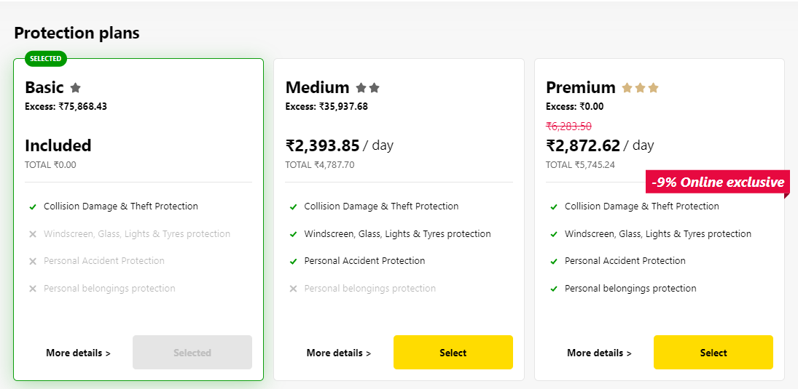
Backing Services in BTP
Each service has one or more service plans available. A service plan is the representation of the costs and benefits for a given variant of a particular service. For instance, a database may be configured with various "T-shirt sizes", each of which is a different service plan.
Choose Your service
Backing Service
Select Plan
Service Plan

Slide 6


Service instance
Car key to use Car
Service Key to Consume Service instance
Actual Car
Service Instance

Slide 7
Service Catalog & Entitlements
The SAP Discovery Center is a relatively new site hosted by SAP for developers and architects to find the services hosted by sap in SAP BTP and their respective service plans available.
It will also help technical team to identify the data center availability and cost associated with each service.
https://discovery-center.cloud.sap/#/serviceCatalog
Entitlements are the heart of all subaccounts in SAP BTP. They define which service and runtime artifacts you are able to use. When you purchase an enterprise account, you’re entitled to use a specific set of resources, such as the amount of memory that can be allocated to your applications.
An entitlement is your right to provision and consume a resource. In other words, entitlements are the service plans that you're entitled to use.
A quota represents the numeric quantity that defines the maximum allowed consumption of a resource. In other words, how much of a service plan you're entitled to use.
Entitlements and quotas are purchased and managed at global account level, from where they’re distributed to subaccounts, which consume them.
When you remove quotas or entitlements from a subaccount, they become available again at global account level and can be assigned to other subaccounts.

Slide 8
Quota Plans
In the Cloud Foundry environment, you can further distribute the quotas that are allocated to a subaccount. This is done by creating space quota plans and assigning them to the spaces.
Space quota plans are optional and are used to limit how much each space can use, not to enable. If you don't create any space quota plans, all spaces in a subaccount using the Cloud Foundry environment have access to all entitlements and quotas in that subaccount. This means that one space could use up all the quota in a subaccount.
If you want to prevent that from happening and set a limit to how much each space can use from the total quota available in the subaccount, you can use quota plans and assign them to spaces.

Slide 9
A Quick History
Hybrid App
Fiori Apps can be converted to APK using cordova plugin with WebIDE tool
Medix
Mendix is a low-code platform that allows users to build applications, including those with SAP Fiori UI styling, without extensive coding
2013
2021
2022
SAP UI5
UI5 framework was introduced to design responsive web applications
AppGyver
AppGyver Oy, a pioneer in no-code development platforms that enable users with no coding skills to build applications for Web and mobile uses
SAP Build
Build Apps combining AppGyver, Medix and Build.me prototyping tool
2015
2021

Slide 10
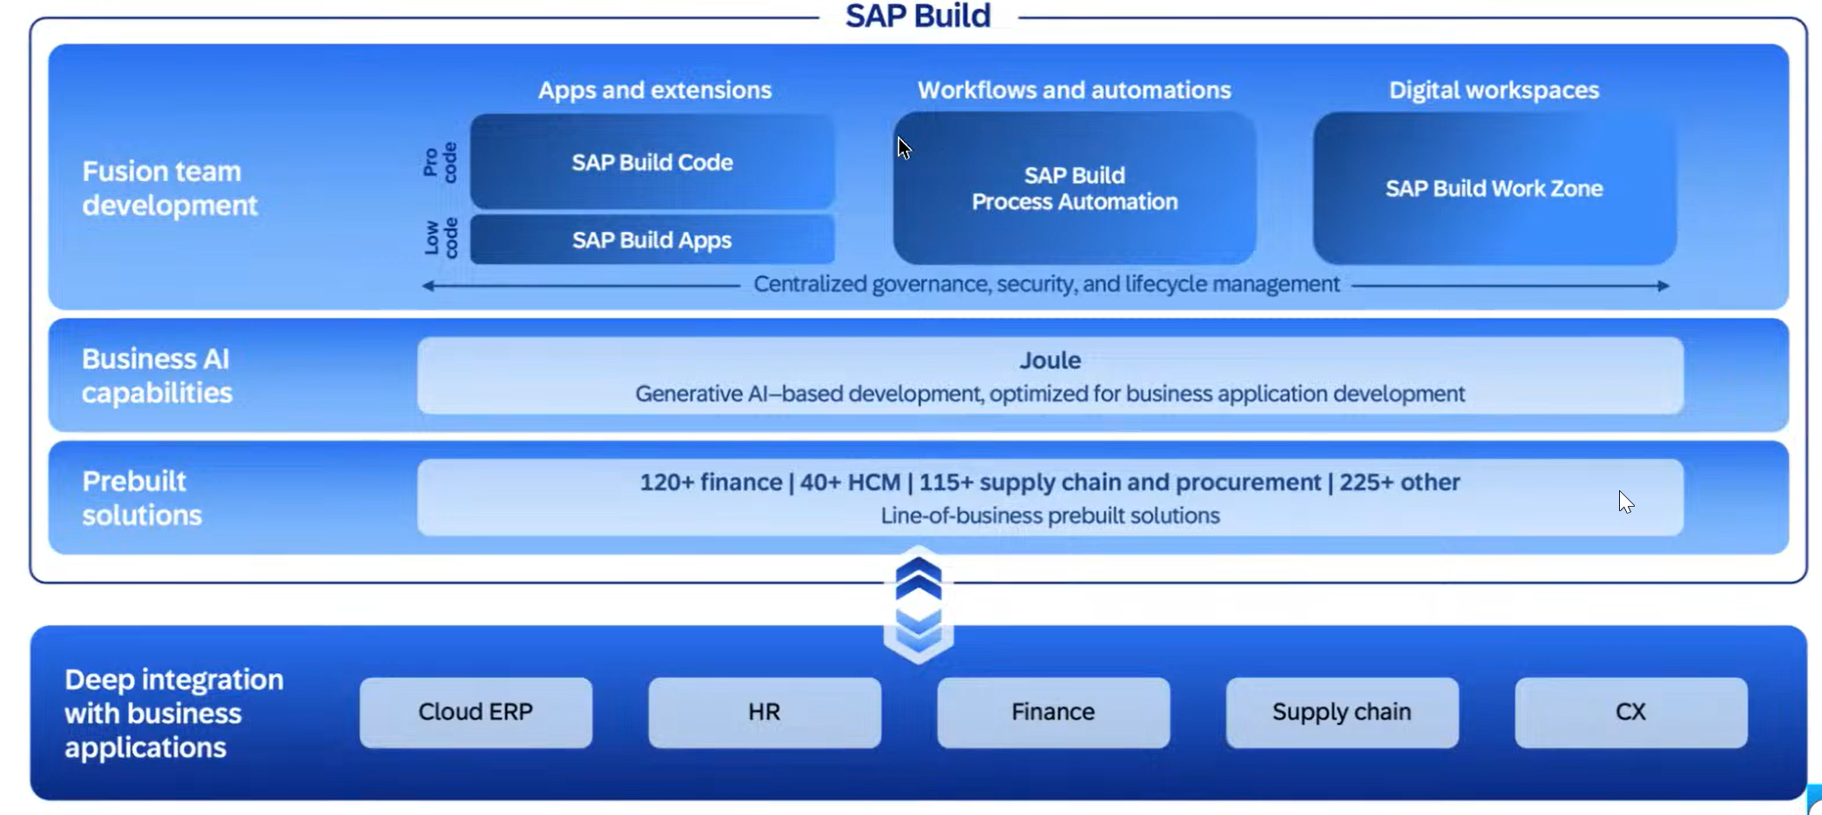
What is SAP Build

Slide 11
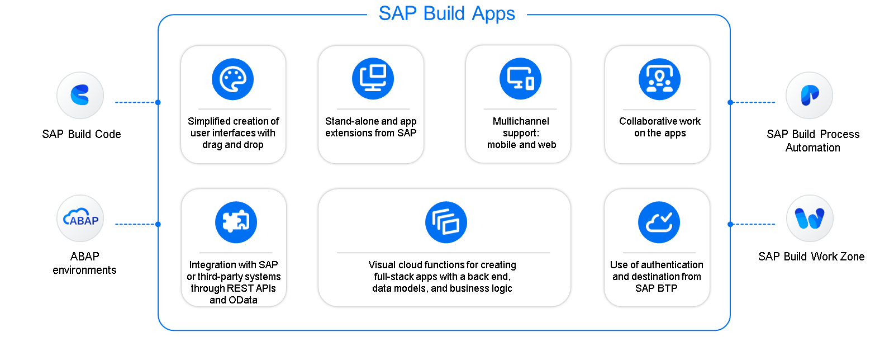
Key Capabilities

Slide 12
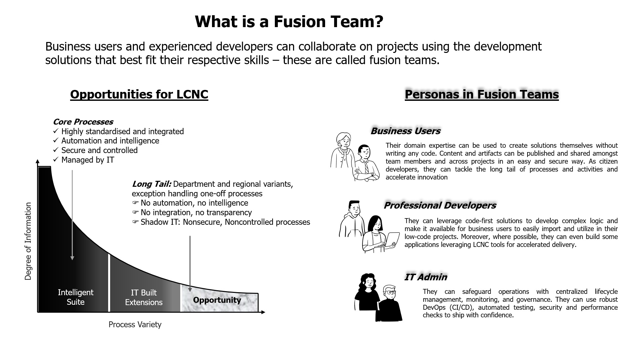
What is fusion Team?

Slide 13
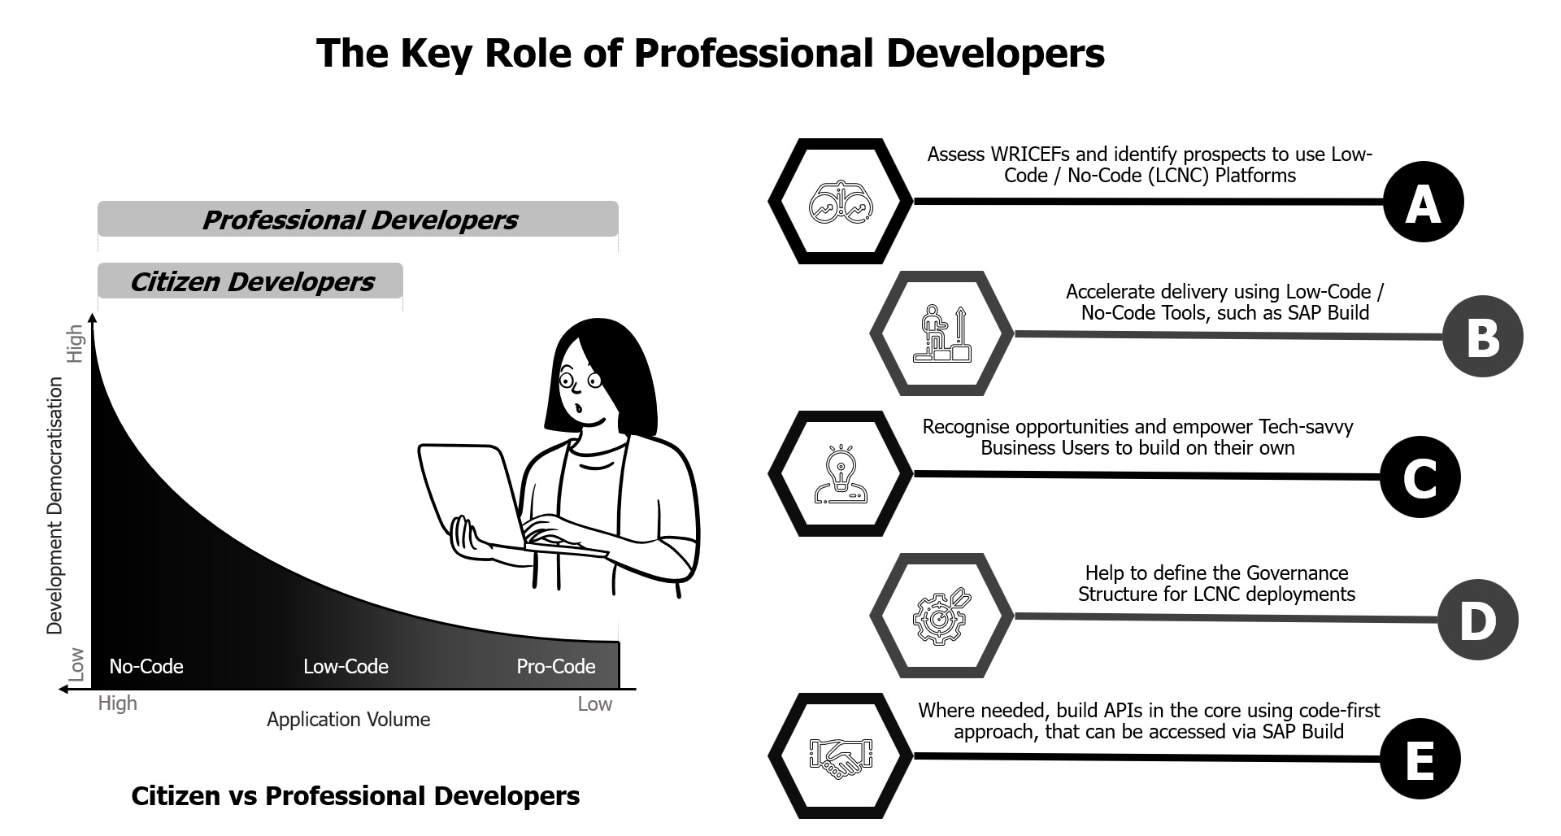
Key role of professional developers?

Slide 14
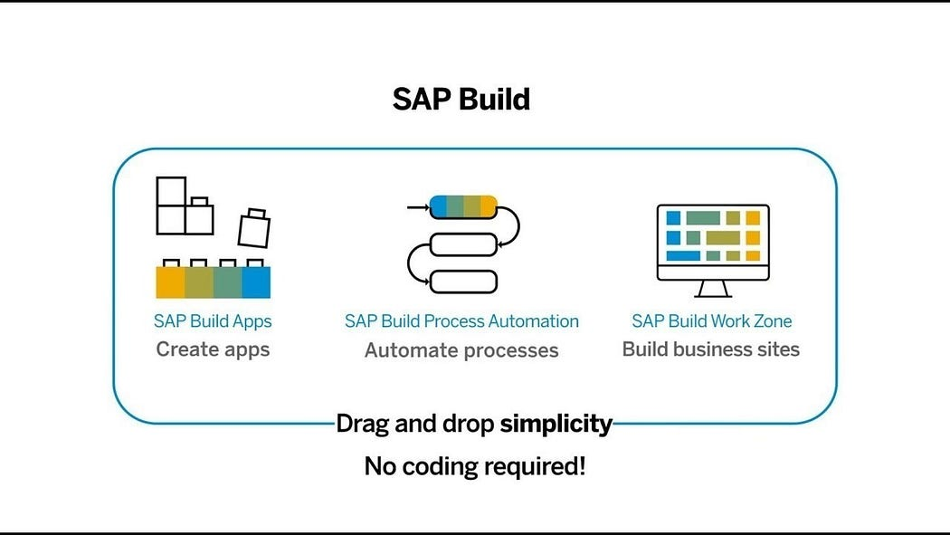
What is SAP Build?
SAP Build is a user-friendly low-code/no-code platform within the SAP Business Technology Platform (SAP BTP), designed to empower users to create, customize, and enhance applications, automate workflows, and build business sites without the need for advanced coding skills. It includes three primary components:

Slide 15
SAP Build Offerings?
SAP Build Process Automation
SAP Build WorkZone
SAP Build Apps
Purpose: Simplify the development of enterprise applications through an intuitive interface. Key Features:
Visual Development: Create UI, workflows, and logic using a drag-and-drop approach.
Prebuilt Templates: Leverage templates for common business scenarios.
Data Integration: Connect seamlessly with SAP and external systems through APIs.
Multi-Channel Deployment: Develop apps for both web and mobile platforms.
Collaboration Tools: Facilitate teamwork during the app-building process. Use Cases:
Developing HR onboarding solutions.
Building custom KPI tracking dashboards.
Creating customer-facing applications for feedback collection.
Purpose: Streamline business processes using workflows and robotic process automation (RPA). Key Features:
Workflow Automation: Manage approvals, notifications, and document routing automatically.
Prebuilt Bots: Access a library of bots to handle repetitive tasks like data entry.
Business Rules Management: Easily define and update business logic.
Process Visibility: Track and optimize workflows in real-time.
AI Integration: Utilize AI capabilities such as document recognition for enhanced automation. Use Cases:
Automating invoice approval workflows.
Managing employee leave requests.
Connecting and streamlining repetitive processes across systems.
Purpose: Design tailored business sites and portals for employees, customers, or partners. Key Features:
Prebuilt Templates: Quickly create branded portals.
Content Integration: Combine apps, dashboards, and workflows in a unified portal.
Role-Based Access: Customize content and permissions according to user roles.
Collaboration Features: Incorporate chat, forums, and knowledge-sharing tools.
Mobile-Friendly Design: Ensure accessibility across all devices. Use Cases:
Developing employee self-service platforms.
Creating customer support portals.
Building collaboration hubs for partners.

Slide 16
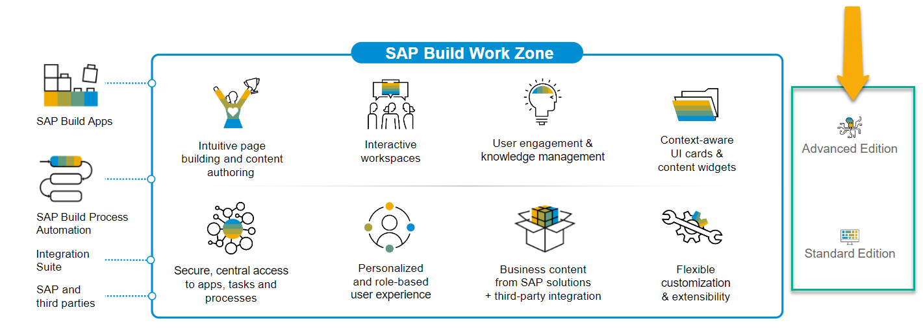
SAP Build Work Zone?
SAP Build Work Zone, advanced edition is a powerful SAP Business Technology Platform service that consists of several components
SAP Launchpad Services is now called SAP Build Work Zone, Standard SAP Work Zone is now called SAP Build Work Zone, Advanced

Slide 17
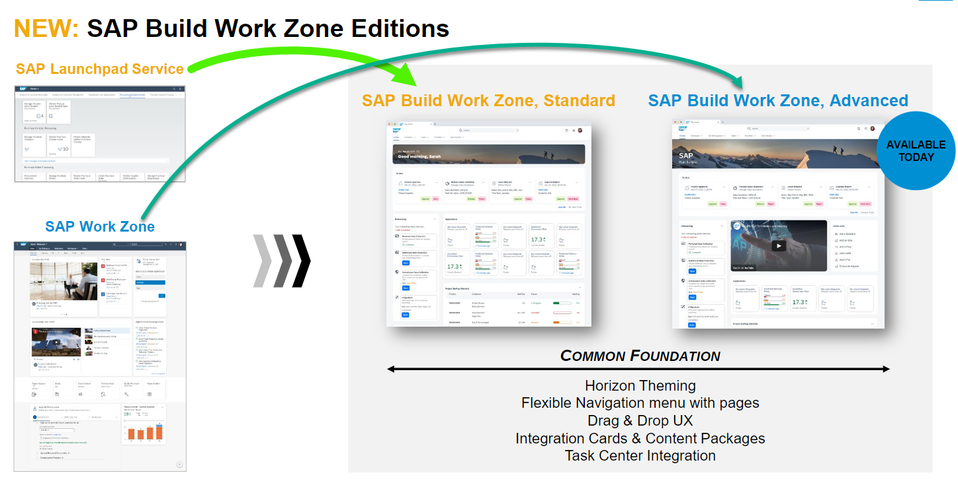
Offerings of Build Work Zone

Slide 18

Hands-on Setting up Build Work Zone

Slide 19
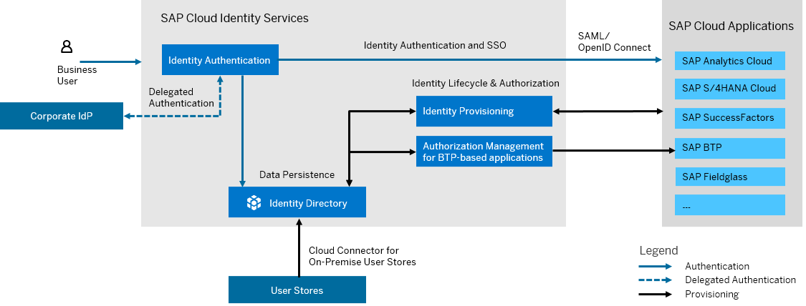
What is SAP Cloud Identity Service?
SAP Cloud Identity Services are a group of services of SAP Business Technology Platform (SAP BTP), which enable you to integrate identity and access management between systems. The goal is to provide a seamless single sign-on experience across systems while ensuring that system and data access are secure. SAP Cloud Identity Services include Identity Authentication, Identity Provisioning, Identity Directory and Authorization Management.

Slide 20
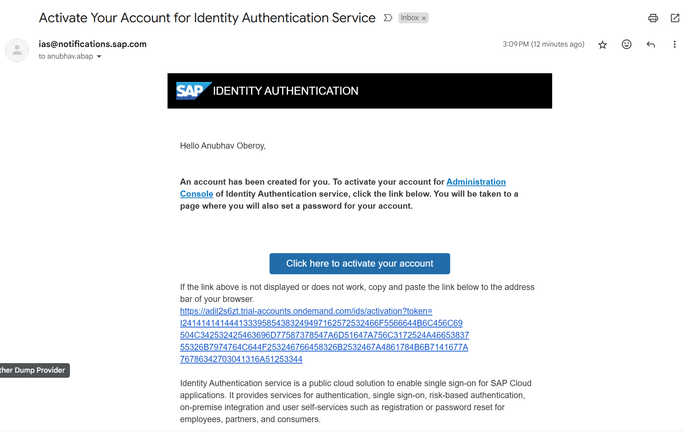
Become Admin for your Identity Service

Slide 21

What We Did
Let’s Summarize

Slide 22

www.anubhavtrainings.com
Thank You
End of Day 2

Slide 23


We’re committed to empower you to be
#FutureReady
through powerful training solutions.
We build the workforce of the future.
250+
Corporate Clients
30,000+
Learners Trained
25000+
Learners Placed
FREE WEBINARS
Sign up for free webinars with industry experts every fortnight!
Enroll Now!
Contact us today!
https://anubhavtrainings.com

